Slide 1


Slide 2


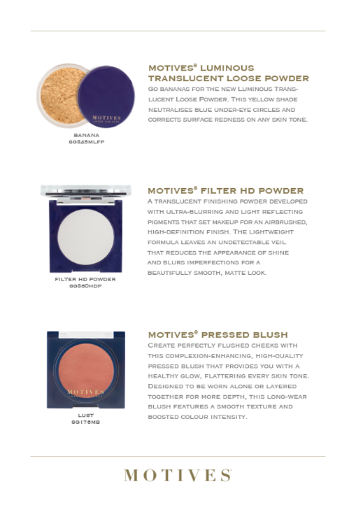

Slide 3
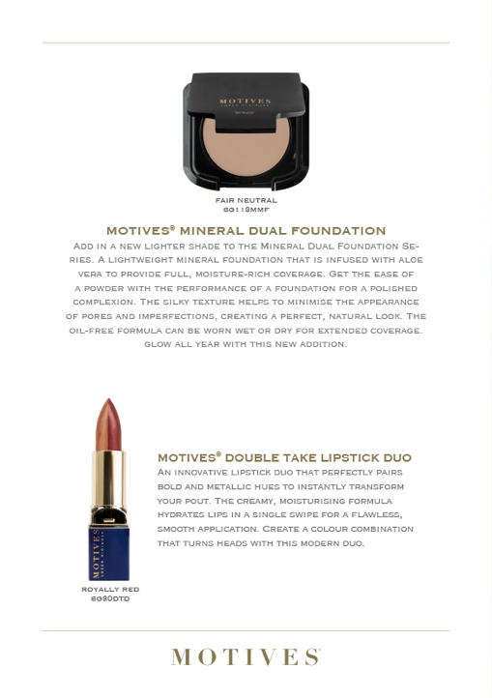

Slide 4


Slide 5
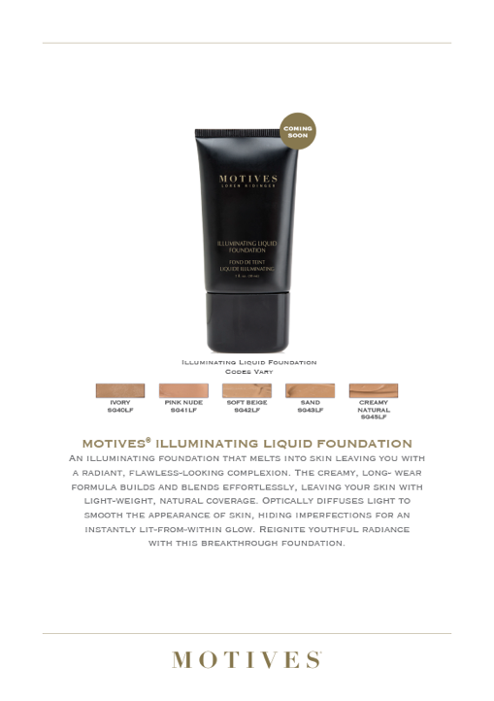

Slide 7
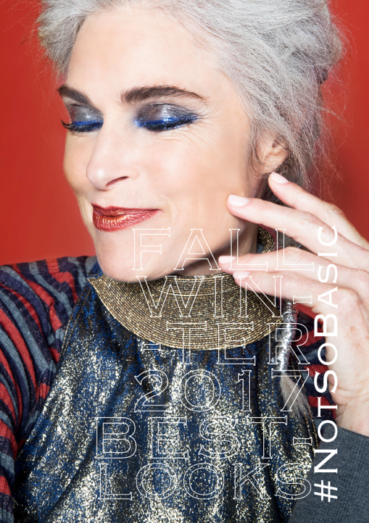

Slide 8
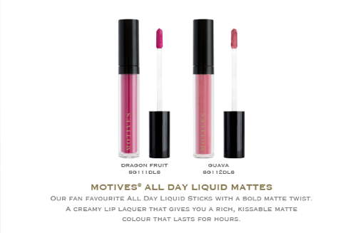

Slide 9
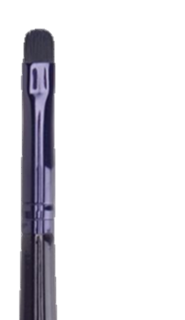
Motives® Detailing Brush

Slide 11

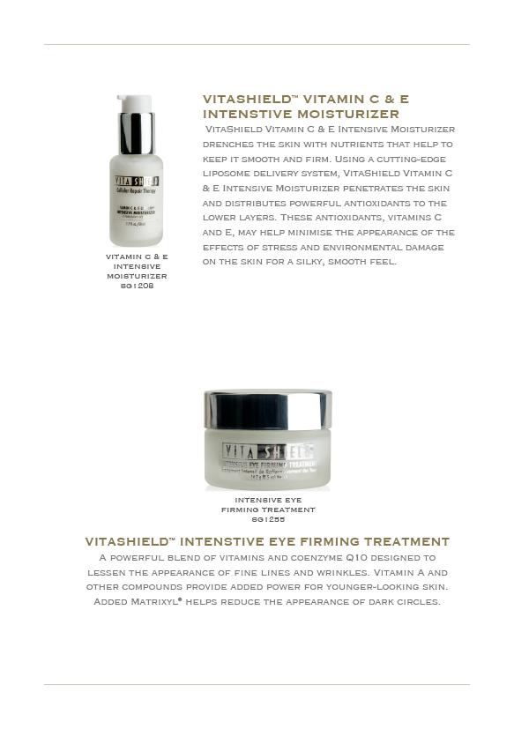

Slide 12



Slide 13

Motives pushes us beyond who we are now and into better versions of ourselves

Slide 14
MARKET SINGAPORE®
NEW PRODUCT LAUNCH

Slide 15
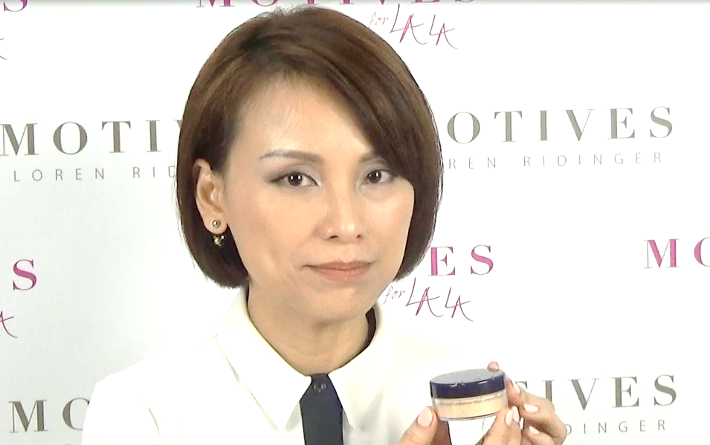
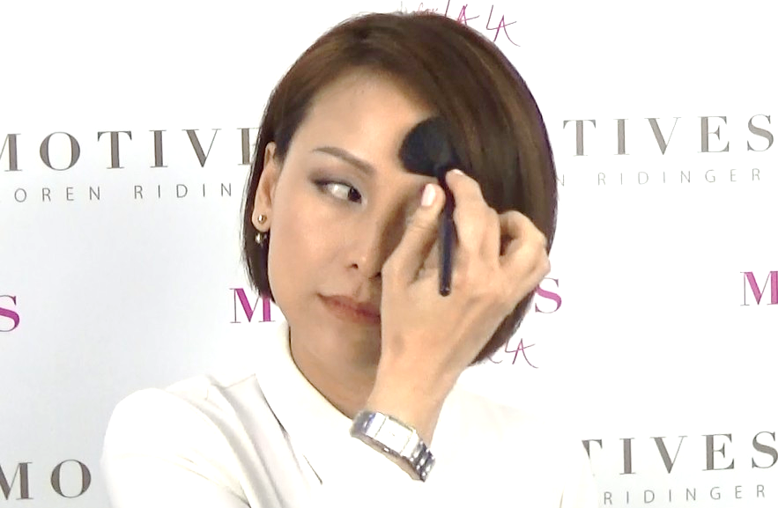


Makeup Tutorial by Motives® Certified Trainer Ivy NG
MOTIVESMASG

Slide 16

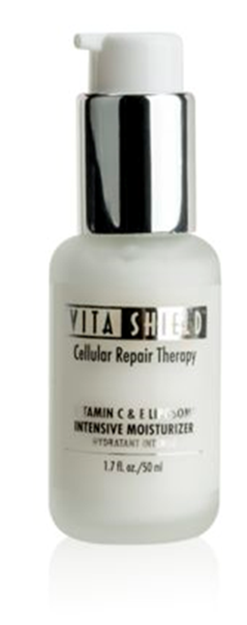
VitaShield™ Vitamin C&E Intensive Moisturizer
Instantly absorbs and gives the skin a silky, smooth texture
Moisturises and lessens the appearance of fine lines
Skin will look and feel younger; facial contours will look more youthfully defined
Minimises the appearance of the effects of stress, fatigue, smoking, pollution and environmental damage
Has soothing properties
NEW
Code: SG1208 I UC:S$62.75 I SR:S$87.95 I BV:34

Slide 17
Key ingredients found in:
Cyclopentasiloxane
Cyclopentasiloxane is a widely used silicone and functions as a skin and hair conditioning agent. As a silicone, it provides finished skin and hair care products with an excellent feel and ease of application. As a skin conditioning emollient, cyclopentasiloxane, lubricates the skin surface to give the skin a smooth and soft appearance.
Ascorbyl Palmitate (Vitamin C)
Ascorbyl palmitate is a stable form of vitamin C. Like Vitamin C, ascorbyl palmitate has antioxidant properties and thus might help protect the skin from oxidative stress and help keep it looking younger.
Tocopheryl acetate (Vitamin E)
Vitamin E is a well-known antioxidant vitamin. Tocopheryl acetate’s antioxidant properties might help protect the skin from oxidative stress and help keep it looking healthy and more youthful.
Code: SG1208 I UC:S$62.75 I SR:S$87.95 I BV:34

Slide 18
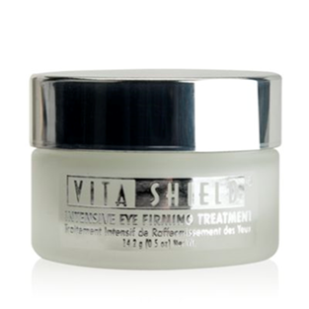
VitaShield™ Intensive Eye Firming Treatment
Designed to defend against and minimise the appearance of the visible effects of stress, fatigue, and environmental damage
Our formulation supports the delicate skin surrounding the eyes.
Supports smoother, firmer-looking skin for a more evenly coloured and healthy-looking complexion.
Regular use can have a profound effect on your skin and help minimise the appearance of fine lines, wrinkles, puffy skin and dark circles.
Moisturises and conditions for smoother, softer-looking skin.
NEW
Code: SG1255 I UC: S$50.00 I SR: S$70.00 I BV:23.50

Slide 19

Key ingredients found in:
Palmitoyl Pentapeptide-4
This breakthrough peptide ingredient supports skin and helps reduce the appearance of fine lines and wrinkles, helps the skin feel smoother, and helps reduce the appearance of dark circles under the eyes.
Coenzyme Q10 (Ubiquinone)
Coenzyme Q10 is an important biochemical factor found naturally in the mitochondria of our skin. It has been suggested that coenzyme Q10 can help protect the skin from oxidative stress, thus supporting a healthier-looking complexion.
Retinyl Palmitate (Vitamin A)
Retinyl palmitate has antioxidant properties and is classified by the cosmetic industry as a skin conditioning agent, suggesting that it can help maintain the skin in good condition and looking healthy and more youthful.
Code: SG1255 I UC: S$50.00 I SR: S$70.00 I BV:23.50

Slide 20



STAY IN TOUCH WITH US
MOTIVES® COSMETICS
MOTIVESMASG
MOTIVESCOSMETICS
SG.MOTIVESCOSMETICS.COM

